Slide 1

Building Modern Mobile Apps
Native Android
Kevin Ford
Mobile Practice Lead
Magenic
Level: Intermediate

Slide 2
Kevin Ford
kevinf@magenic.com
@Bowman74
http://windingroadway.blogspot.com/
https://github.com/Bowman74

Slide 3
Mobile Tasks Source Code
GitHub
https://github.com/brentedwards/MobileTasks

Slide 4
What is Native Android Development?

Slide 5
History
Created by Google
First Android beta SDK Launched Nov. 2007
1.0 Version by Sep 2008
Versions use named based theme
Android Studio Stable Released Dec 2014
Java is the Primary Language

Slide 6
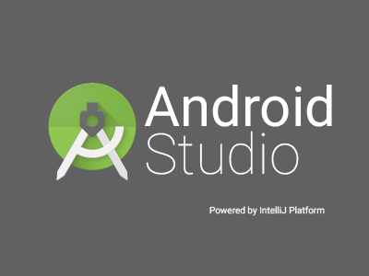

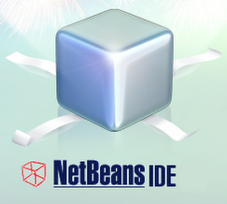

History of Android IDEs

Slide 7
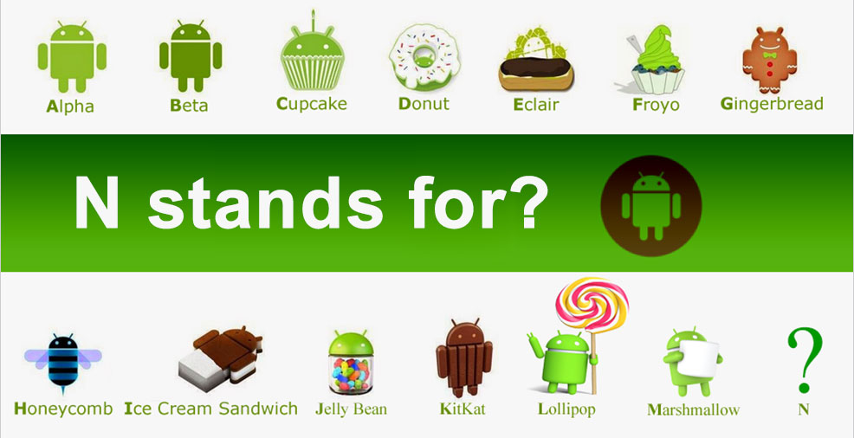

Slide 8


Slide 9


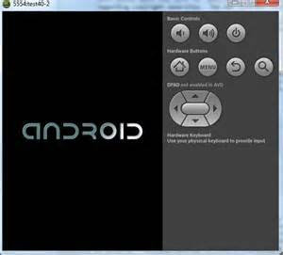

There are a lot of moving parts

Slide 10
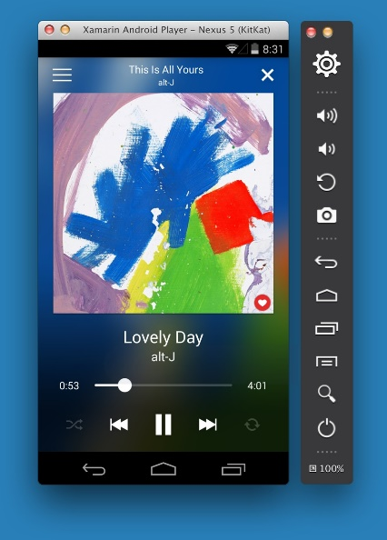
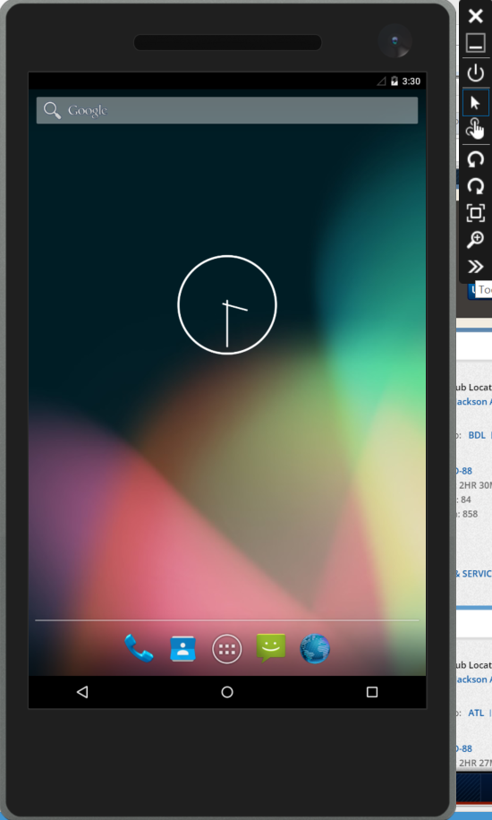
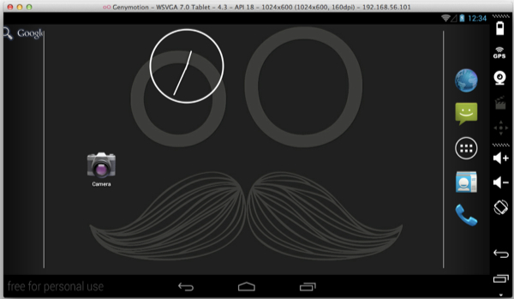
Default Emulator

Slide 11
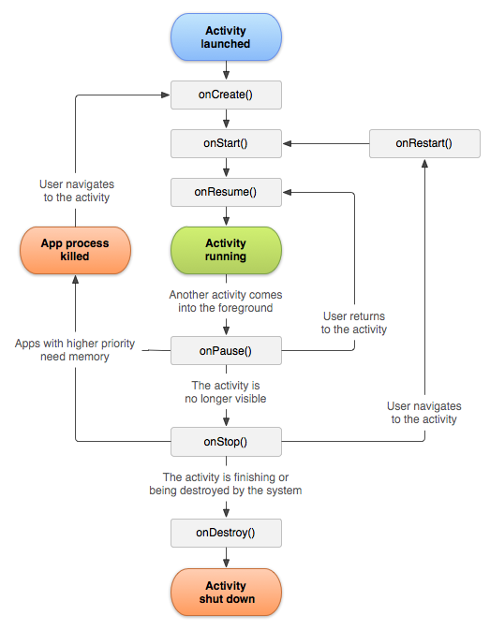
Lifecycle

Slide 12

Gradle

Slide 13
Activities and Intents
Activity 2
Activity 1
Activity 1

Slide 14
Android Foundational Concepts
Layouts
Controls
Styles

Slide 15
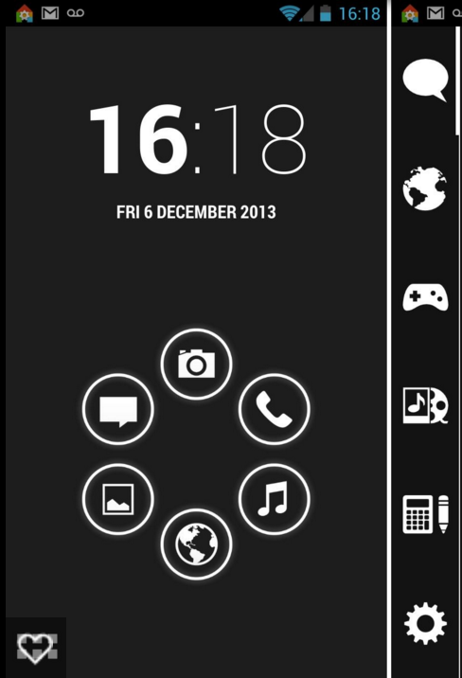
Layouts
Linear Layout
Relative Layout
Web View

Slide 16
Layouts
Linear Layout
Relative Layout
Web View

Slide 17
Layouts with Adapters
List View
Grid View

Slide 18
Common Controls
Button
EditText
CheckBox
RadioButton
Switch
Spinner

Slide 19
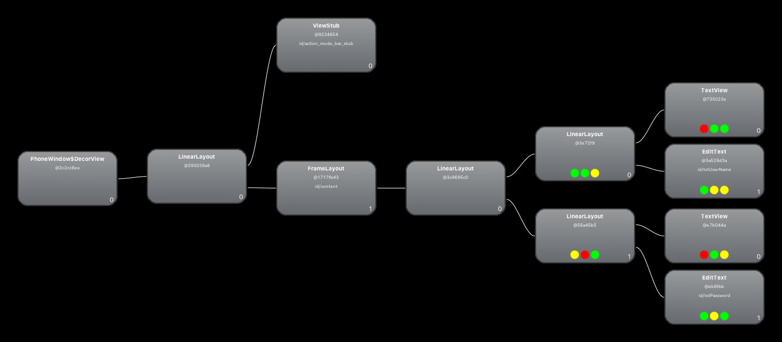
Hierarchal

Slide 20
Phones vs. Tablets
Single Binary
No True Differentiation
Adaptive Through Resources

Slide 21
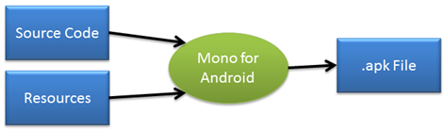
Resources
Contain Strings, Layouts, images, etc
Vary Based on Several Factors
Controlled by Directory Stricture
Language
Resolution
Orientation

Slide 22
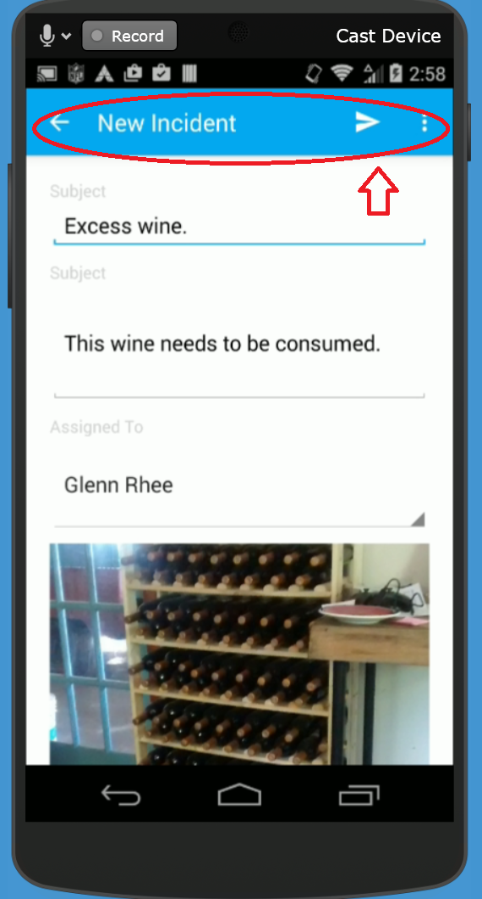
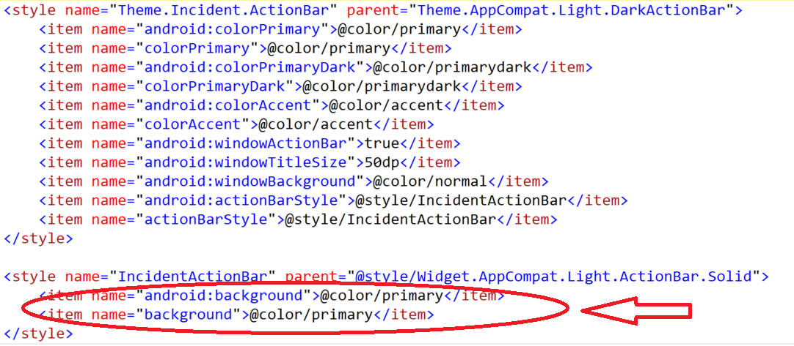
Android Styles

Slide 23
Connecting to Azure
Gradle Compile
com.microsoft.azure:azure-mobile-android:3.0
Async done via ListenableFuture
Json handling via GSon

Slide 24
Azure Authentication
public ListenableFuture authenticate (MobileServiceAuthenticationProvider provider) { ListenableFuture<MobileServiceUser> userFuture = networkSerice.getClient().login(provider); final MobileServiceAuthenticationProvider requestedProvider = provider; final SettableFuture result = SettableFuture.create(); Futures.addCallback(userFuture, new FutureCallback<MobileServiceUser>() { @Override public void onSuccess(MobileServiceUser user) { // Do Success Code result.set(null); } @Override public void onFailure(Throwable t) { result.setException(t); } });

Slide 25
Conclusion
Excellent Choice For Android Only Environment
Android Studio Improved Development Performance
Fast Compile and Deploy Times
No Cross Platform Sharing Opportunities
Always can use the latest Android APIs
Can Develop on Windows and OSX

Slide 26
Questions?

